Slide 1
Data mining
U.S. Census of Income,1994
Group 10
1. 李文锐 2030005036
2. 蓝一凯 2030005032
3. 叶中宇 2030005069
4. 王一安 2030005058
5. 陈俊霖 2030005004
Notes:
Are your classroom colors different than what you see in this template? That’s OK! Click on Design -> Variants (the down arrow) -> Pick the color scheme that works for you!
Feel free to change any “You will…” and “I will…” statements to ensure they align with your classroom procedures and rules!

Slide 2

Introduction
1. 李文锐 2030005036
Adult dataset: “Census Income” data set from the 1994 U.S. Census database.
48842 observations; training data: 32561, test data: 16281.
23.93% of the total annual income is more than 50k $, and 76.07% of the total annual income is less than 50k $
Purpose: forecast whether the annual income exceeds 50k$
Class: whether the annual income exceeds 50k $

Slide 3

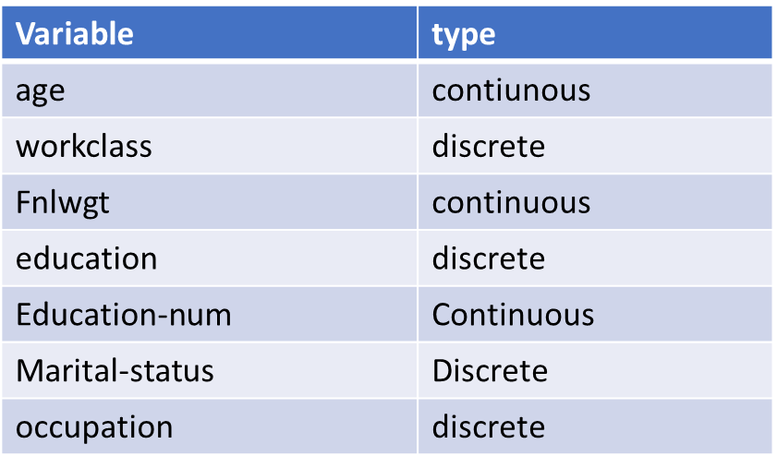
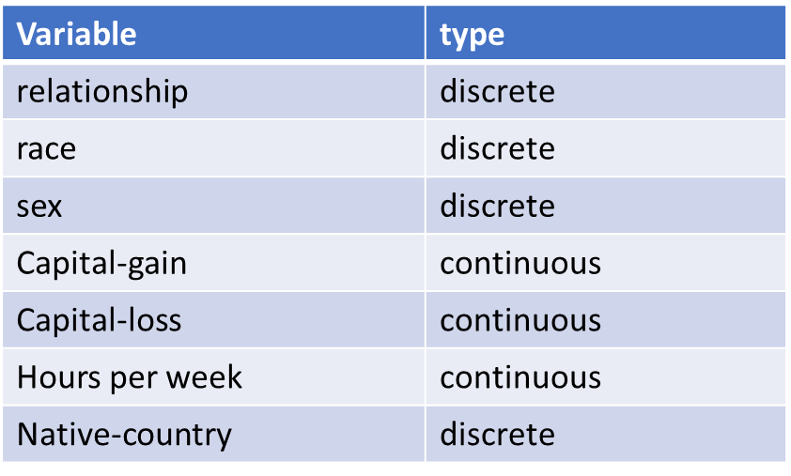
Introduction
Basic Properties: 14 categorical variables
Attribute: age, workclass, fnlwgt, education, education-num, marital status,…
Properties: discrete & contiunous

Slide 4

Data Preprocess
2. 蓝一凯 2030005032
Missing Value: filled by mode of this category
Replace the income by using number( <=50 -->0 & >50 --> 1)
Cancel `Capital-gain` and `Capital-loss` two categories, because there are more than 75% of people do not have them, they are irrelevant categories.

Slide 5
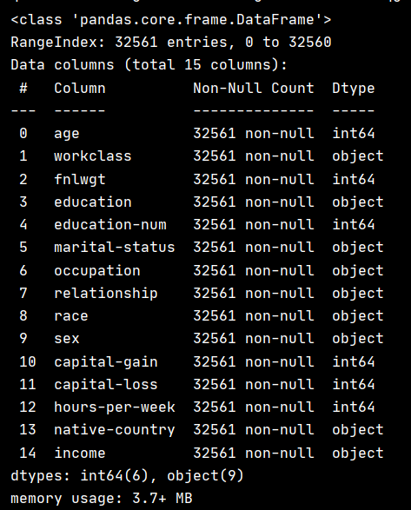
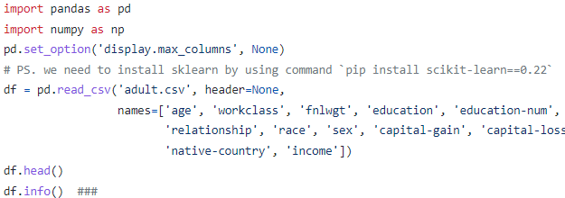
Data Preprocess
Missing Value
First, directly search data for null values.

Slide 6

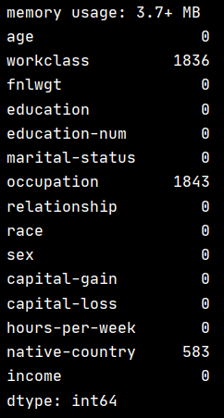
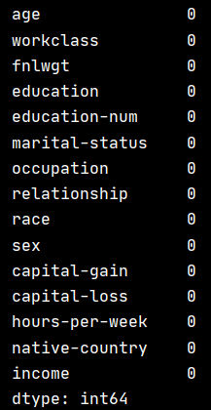
Data Preprocess
Missing Value
We found that some missing values in the original data were '? '. So we continue to search for '? 'data.

Slide 7
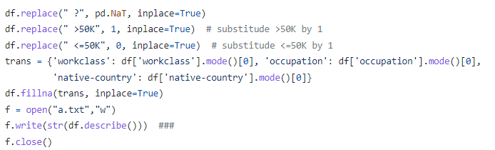
Data Preprocess
Income Replacement
Revenue can be divided into two types, which we have simplified. Replace >50K with 1, and <=50K with 0.

Slide 8
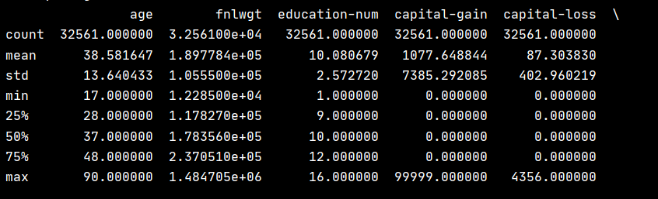
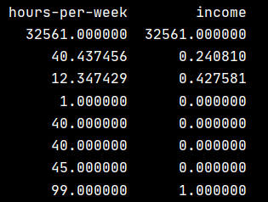
Data Preprocess
Cancel Irrelevant Attributes
As can be seen from the above table, std of capital-gain and capital-loss are very huge which will cause the effct of classification badly. And more than 75% people have no capital-gain and capital-loss., so the 2 attributes cannot represent the majority. We delete them as we considered them irrelevant.

Slide 9

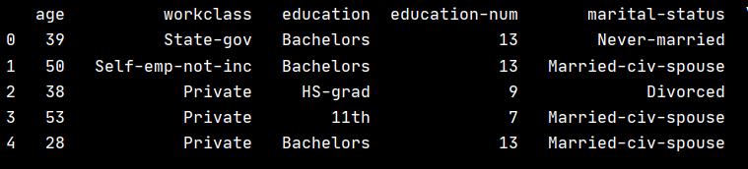
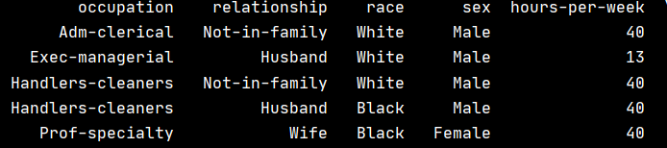
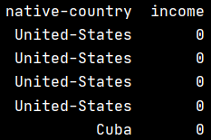
Data Preprocess
Cancel Irrelevant Attributes
The result after removing the irrelevant attribute.

Slide 10
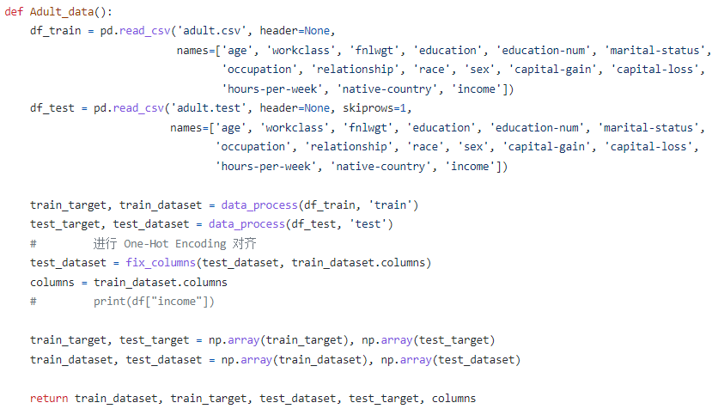
Common code illustration
3. 叶中宇 2030005069

Slide 11
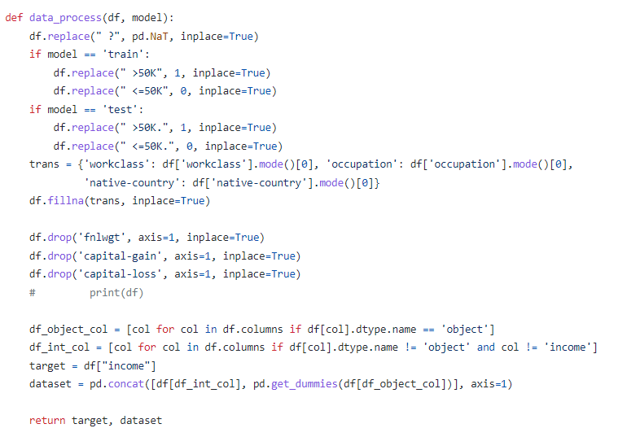

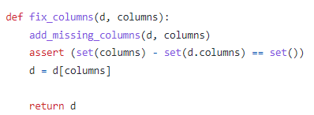
Common code illustration

Slide 12
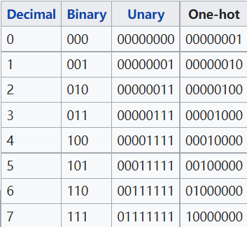
Concept: One-hot encoding
Convert string to One-hot encoding:
1. save the stroage
2. easier to show the label of category for each node

Slide 13
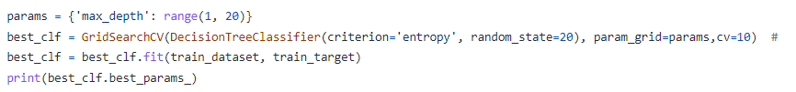
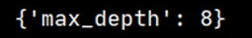
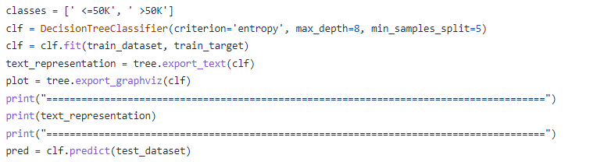
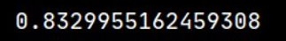
Model 1: Construction – Decision Tree
Use `GridSearchCV` to determine what is the best depth for decision tree.
Use entropy as an criteria to determine whether this node needs to be splited.

Slide 14
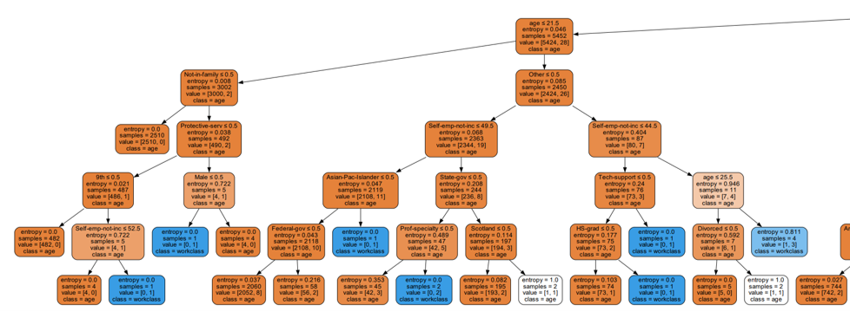
Tree Plot (Part of)

Slide 15
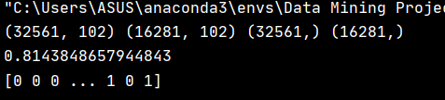
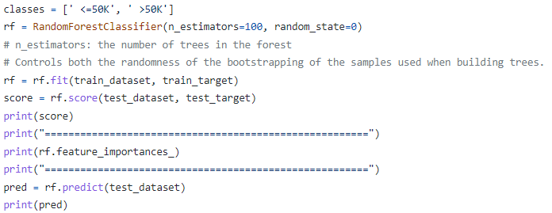
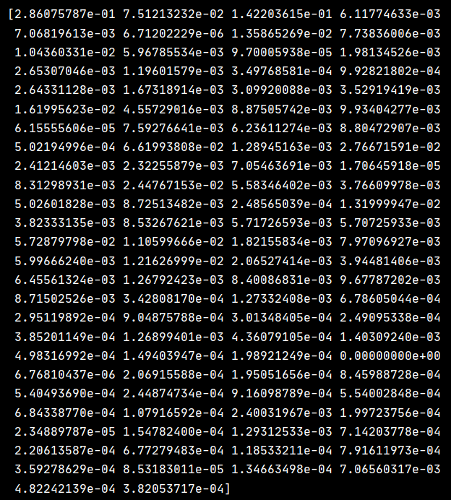
Model 2: Random Forests

Slide 16
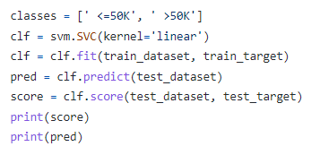

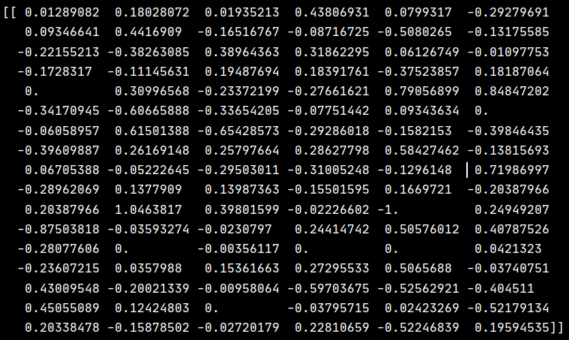
Model 3: Construction -- SVM
4. 王一安 2030005058
Accurancy:
Parameters:
Support vector: 3780

Slide 17
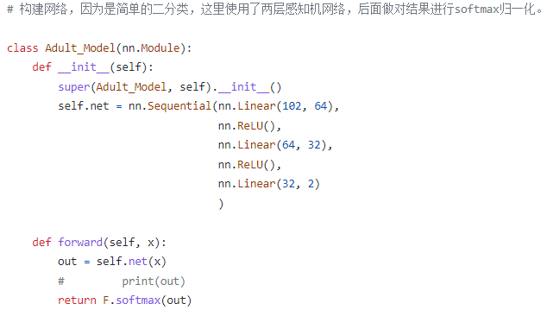
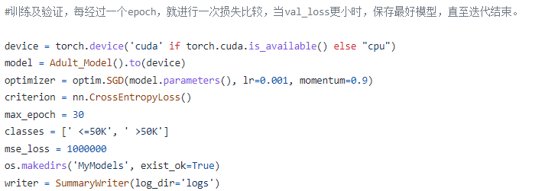
Model 4: Deep Learning (Neuron Network)
Construct the neuron network, we used network with two layers
Define the times of trainning, after each iteration, keep saving the best model.

Slide 18
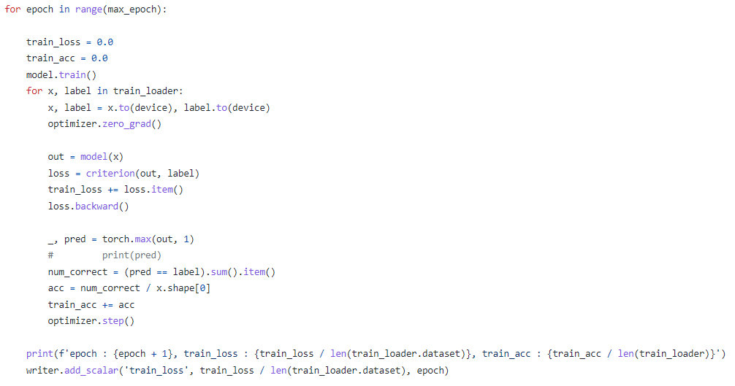
Model 4: Deep Learning (Neuron Network)
Trainning the model

Slide 19
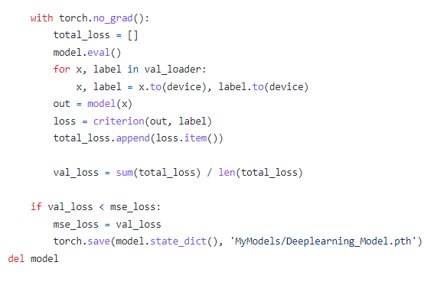
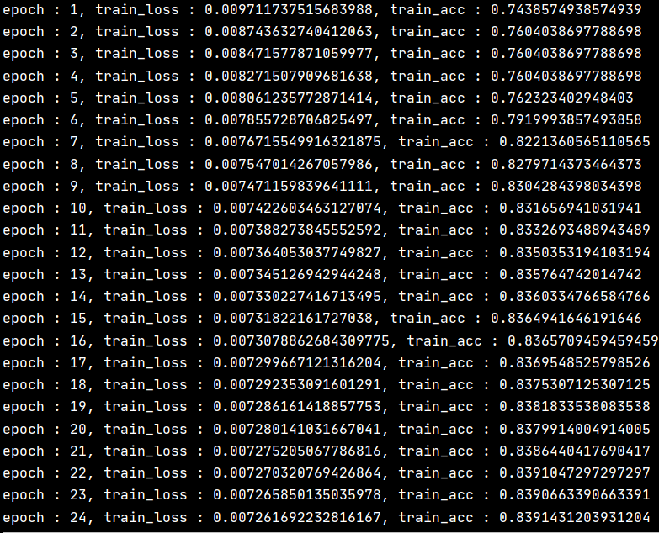
Model 4: Deep Learning (Neuron Network)
Trainning the model

Slide 20
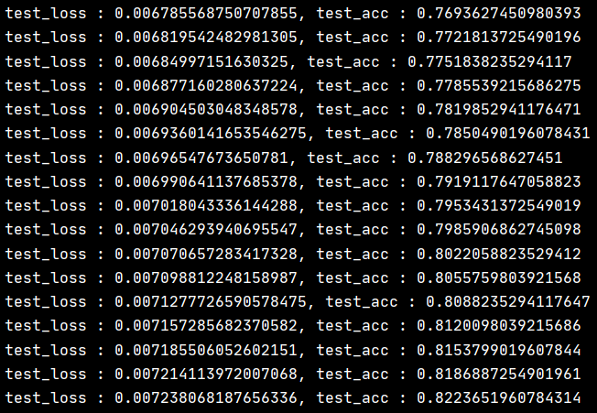
Model 4: Deep Learning (Neuron Network)
Trainning the model

Slide 21
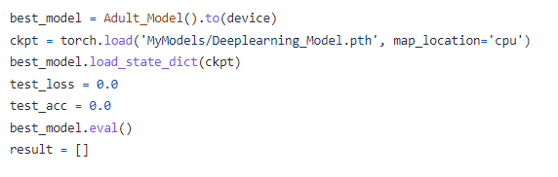
Model 4: Deep Learning (Neuron Network)
Fetch the best model from CPU

Slide 22
Model 4: Deep Learning (Neuron Network)
Test Result

Slide 23

Conclusion: model comparison
5. 陈俊霖 2030005004
According to the prediction results in the test set of the Adult dataset, the accuracy of the deep learning model, decision tree, support vector machine and random forest is 0.831, 0.833, 0.834 and 0.814 respectively, and the accuracy of the four models is similar.
Reasons for low accuracy… | Resolvent...
The robustness of the model is not enough. There is a large number of discrete data in the dataset, and the data is highly sparse after the unique heat coding. | To adjust the parameters of the model searchingly, you can consider increasing the complexity of the model, and pay attention to over fitting in the process, make sure you are completing your class job, if you have one Do not select the method of exclusive hot coding to reduce the dimension of data, and you can consider embedding

Slide 24


Thank you for listening!
Code: https://github.com/g20021215/Data-Mining-2022
Dataset: https://archive.ics.uci.edu/ml/machine-learning-databases/adult/

